Slide 1
Guillotines, Sat-Nav and the Query Optimiser DAVID aLCOCK @SQLSeeker77 What have guillotines and satellite navigation got to do with querying SQL Server? In this session you’re going to find out! We’ll be looking into query performance and that means reading query plans, but in order to do that we also need some background knowledge of how the query optimiser works. With that in mind we’ll be jumping right into optimisation phase, stages, hints and rules. We’ll also learn how to keep track and influence how the engine optimises our queries, and we’ll see if it’s a good idea or not.

Slide 2
THIS SESSION: OPENING UP THE OPTIMISER
What the query optimiser is and what it does.
Look into how the optimiser works:
Phases, Stages and Transformation Rules
Performance aspects of the query optimizer.
Explore optimiser information via DMV’s and Trace Flags.
Influencing the optimiser, and we’ll try to break it!
Assess query and optimiser performance.
Write better queries.
Improve the design of our databases.
Expand our knowledge on guillotines too!!

Slide 3
WHO THE HECK IS THIS GUY?! (David Alcock)
Principal Consultant for DTA IT Consultancy (no relation to the Data Tuning Advisor).
Specialise in building and optimising Data Platforms.
Started out as a VB6 developer, moved through Dev, BI & DBA roles before settling on Data Professional.
Is terrible at PowerPoint (I have no idea why it chose a chicken/turkey!!!).

Slide 4
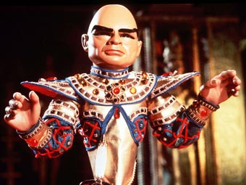
Other things about me:
Arch Nemesis of the Thunderbirds!
Talks A LOT!
Uses bribery generosity for good feedback!
IOU!

Slide 5

FUN FACTS ABOUT GUILLOTINES!

Slide 6
WHEN WAS THE GUILLOTINE INVENTED?
1789 Dr. Joseph-Ignace Guillotin

Slide 7

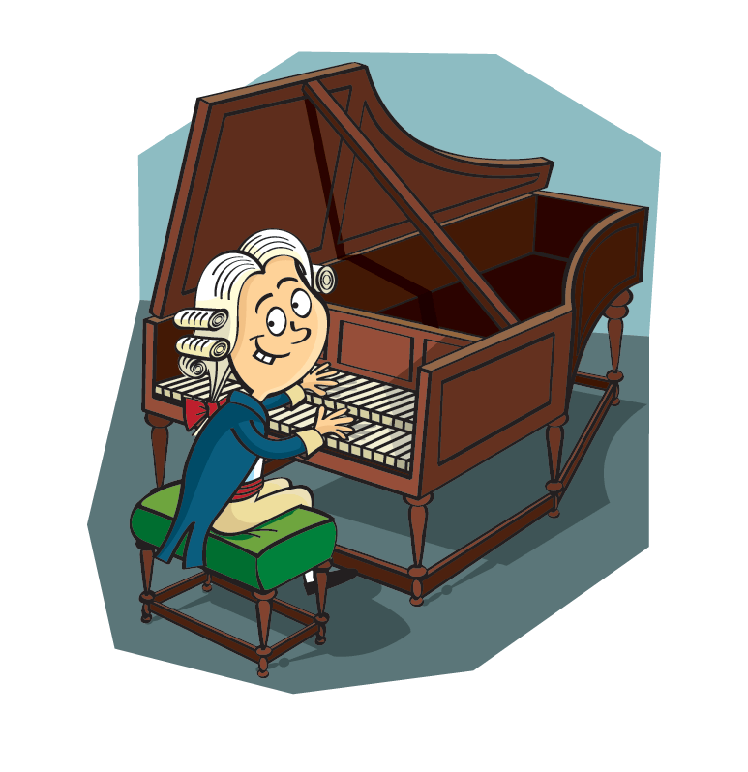
BONUS SLIDE!
Dr. Joseph-Ignace Guillotin wanted to design a more humane method of execution.
Oversaw the development of the first prototype.
Designed by a doctor, Antoine Louis.
Built by a German harpsichord maker named Tobias Schmidt.

Slide 8
WHEN DID IT CLAIM ITS FIRST VICTIM?
1792

Slide 9
WHEN WAS THE LAST PUBLIC EXECUTION BY GUILLOTINE IN WESTERN EUROPE?
1977

Slide 10
WHEN WAS IT FINALLY ABOLISHED?
1981

Slide 11
WHICH FUTURE CELEBRITY WAS PRESENT IN THE CROWD FOR THE PENULTIMATE PUBLIC EXECUTION (in 1939, as public execution was banned until 1977)?
CHRISTOPHER LEE

Slide 12

DATABASE EXECUTION ENGINE

Slide 13
HISTORICALLY THE GUILLOTINE WASN’T THE DEFAULT OPTION FOR EXECUTIONS (WTH POWERPOINT - DINNER TIME?!)
INSTEAD THE GUILLOTINE TENDED TO BE USED FOR THOSE WHO OFFERED THE EXECUTIONER A HANDFUL OF SILVER FOR A SPEEDIER AND NON-BOTCHED EXECUTION.
PROVIDING SPEEDIER EXECUTION FOR OUR QUERIES IS EXACTLY WHAT THE OPTIMISER IS DESIGNED TO DO…!!!!

Slide 14

The T-SQL language
T-SQL is a DECLARATIVE language
It’s not an IMPERATIVE language
Imperative languages use an approach that exactly follow the code. In other words, they do exactly as they’re told:
10 PRINT “DAVE IS AWESOME”
20 GOTO 10
T-SQL works differently as the engine determines the best way to return the results that we’ve asked for in the form of an execution plan.
In a similar way (and to really help with the session title), it works a little like Sat-Nav ☺

Slide 15
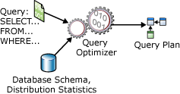
Query Processing Architecture Guide

Slide 16
QUERY OPTIMISATION PHASES
PARSING
BINDING
SIMPLIFICATION
TRIVIAL PLAN?
FULL OPTIMISATION

Slide 17

SIMPLIFICATION DEMO
The optimiser will perform rewrites of the logical tree to simplify the query for optimization; simplifications include:
JOIN ELIMINATION
CONTRADICTION REMOVAL
AND MORE!

Slide 18

TRIVIAL PLANS DEMO
If there’s one (or most likely one) obvious way to execute a query then the engine will use trivial plan optimisation.
If a trivial plan is used the expense of full optimisation is avoided (which is worth it for more complex queries).
Only used for very simple and straightforward queries.
Optimisation level (trivial or full) is visible in the execution plan properties.

Slide 19
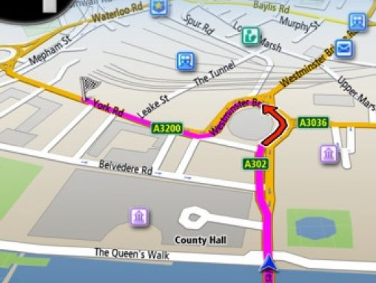
QUERY HINTS
HINTS OVERRIDE THE OPTIMISERS DECISION MAKING
DO WE ACTUALLY KNOW BETTER THAN THE OPTIMISER?
VERY RARE OCCASSIONS
ALMOST ALWAYS - THEY’RE A BAD IDEA
SERIOUSLY!
YOU WOULDN’T OVERRIDE SAT-NAV WOULD YOU???

Slide 20
FULL OPTIMISATION PHASE
PRODUCES A NUMBER OF CANDIDATE PLANS.
USES A COST BASED DECISION.
* Lowest cost returned in the fastest time.
INTERNAL THRESHOLD DURING STAGES.
DOESN’T ASSESS EVERY POSSIBLE PLAN

Slide 21
DECISIONS, DECISIONS!
INDEXES
JOIN TYPE
JOIN ORDER
SCAN/SEEK
SERIAL/PARALLEL

Slide 22
A “SIMPLE” QUERY
SELECT * FROM TABLE1
INNER JOIN TABLE2
INNER JOIN TABLE3

Slide 23
TABLE1
TABLE1
TABLE2
TABLE2
TABLE3
TABLE3
TABLE3
TABLE2
TABLE1
3 DECISIONS BASED ON WHAT ORDER TO JOIN TABLES.
FOR EACH JOIN WE HAVE 3 DECISIONS (NESTED LOOP, MERGE OR HASH)
FOR THIS “SIMPLE” QUERY THERE’S 18 DECISIONS TO BE MADE BY THE OPTIMISER…SO FAR

Slide 24
OPTIMISER TIME OUT!
The Optimiser HAS TO return an execution plan even if the plan is not as efficient as what it could be.
Uses an internal timeout value.
Not strictly time based but based on number of transformations and elapsed time.
If this condition is met the optimiser returns the best plan at that time.
Visible in the execution plan properties under ‘reason for early termination’:
Is this a red flag?
The more overly complex the query the more likely a timeout will occur.
Nested objects!

Slide 25
STAGES OF FULL OPTIMISATION
STAGE 0 (Transaction Processing)
STAGE 1 (Quick Plan)
STAGE 2 (FULL OPTIMISATION?!)
Each stage has certain criteria for entry and contains a specific set of transformation rules
Stage 2 has ALL rules.
Query the DMV for instance level information: sys.dm_exec_query_optimizer_info
Trace Flags 3604 & 8675

Slide 26
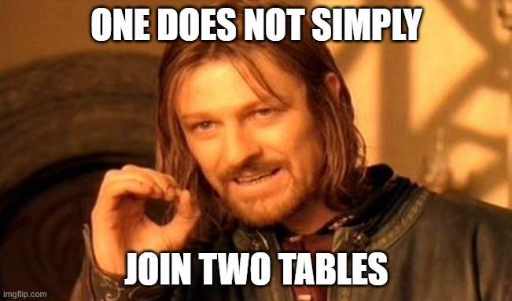

Slide 27
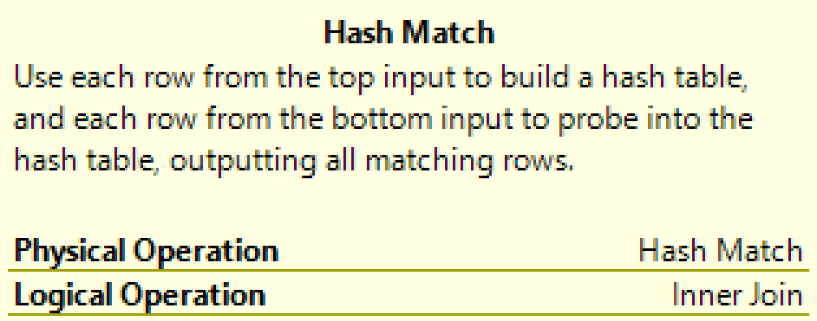
TRANSFORMATION RULES
Use a pattern and substitutions.
# of rules change in each version of SQL Server.
Logical expression of an INNER JOIN
Physical expression could be HASH MATCH, NESTED LOOP or MERGE JOIN.
We use query hints to disable rules.
Use DBCC statement or the dm_exec_query_transformation_stats DMV to view rules. (NOT SUPPORTED)
Optimiser stores information in an internal structure called the memo.
We can use TF’s 8608 and 8615 to view the initial and final memos

Slide 28

HELPING THE OPTIMISER!
Keep the engine up to date
Solid database design principles (keys, constraints etc)
Keep queries as simple as possible
Check your queries
Make use of the Query Store
Keep your queries in cache
Use query hints sparingly (and if you do, don’t forget about them)
Keep statistics up to date

Slide 29
THANK YOU!
Any questions?
Find me on Twitter @SQLSeeker77
Look me up on LinkedIn
Email me at david@dtaconsult.co.uk
STAY SAFE
TAKE CARE

